Slide 1




Flowering Trends of Monarch Nectar Plants
Carrie Stine
Kathy Gerst, Erin Posthumus
USA National Phenology Network
Arizona Space Grant Symposium
22 April 2017
Notes:
----- Meeting Notes (4/5/17 11:27) -----
Move butterfly map to beginning-lead with the why (life cycle takes the across much of the country) that's why we need to know more about flowering and where
Include graph of monarch life cycle
Explain importance of nectar plants (why nectar plants are used)
Better define "Butterfly Milkweed" (use asclepias name) and overall dataset
Started out with multiple species

Slide 2
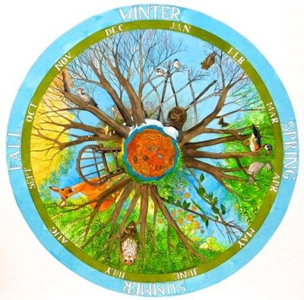
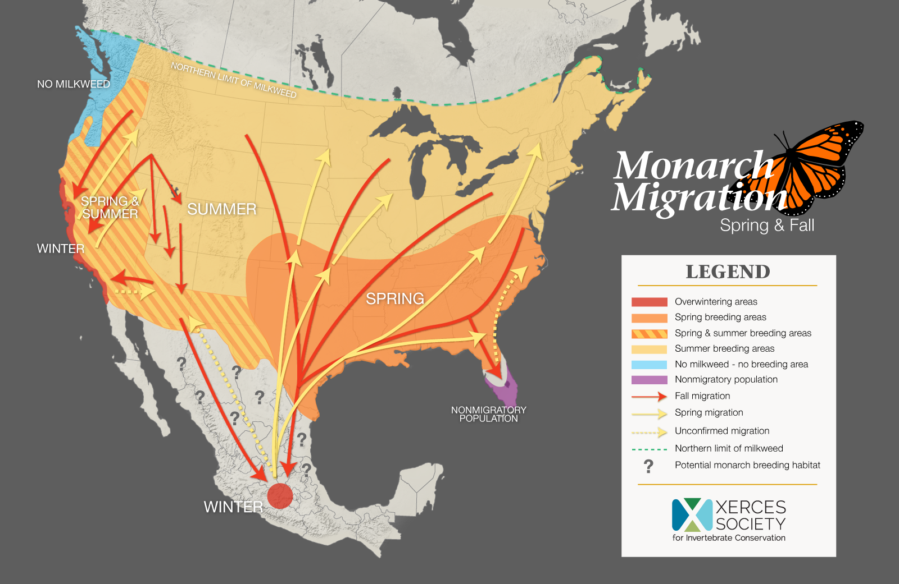
What is Phenology?
Cyclical/seasonal
biological events
Migration, breeding,
flowering
  Onset, Peak, End Dates
http://partnersinplace.com/gallery/view/witness-tree-studio-day

Slide 3
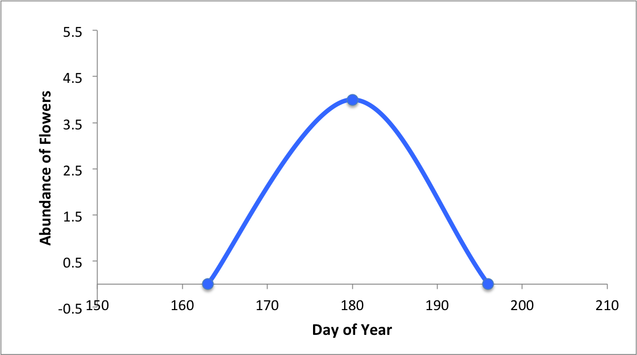
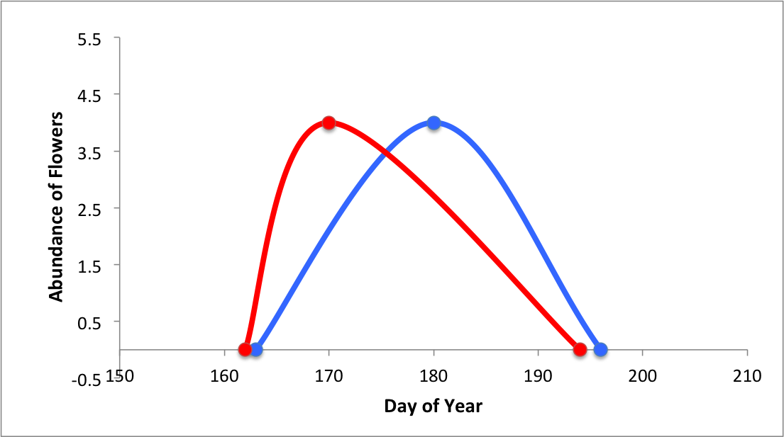
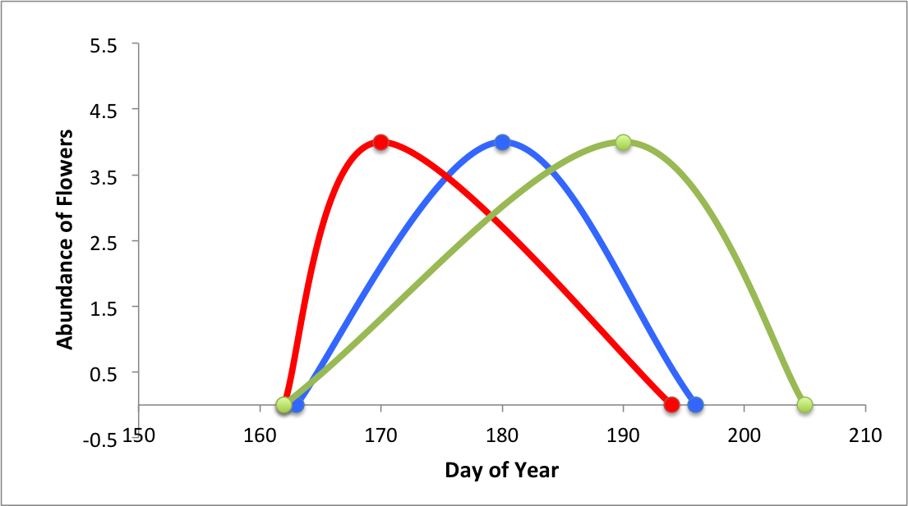
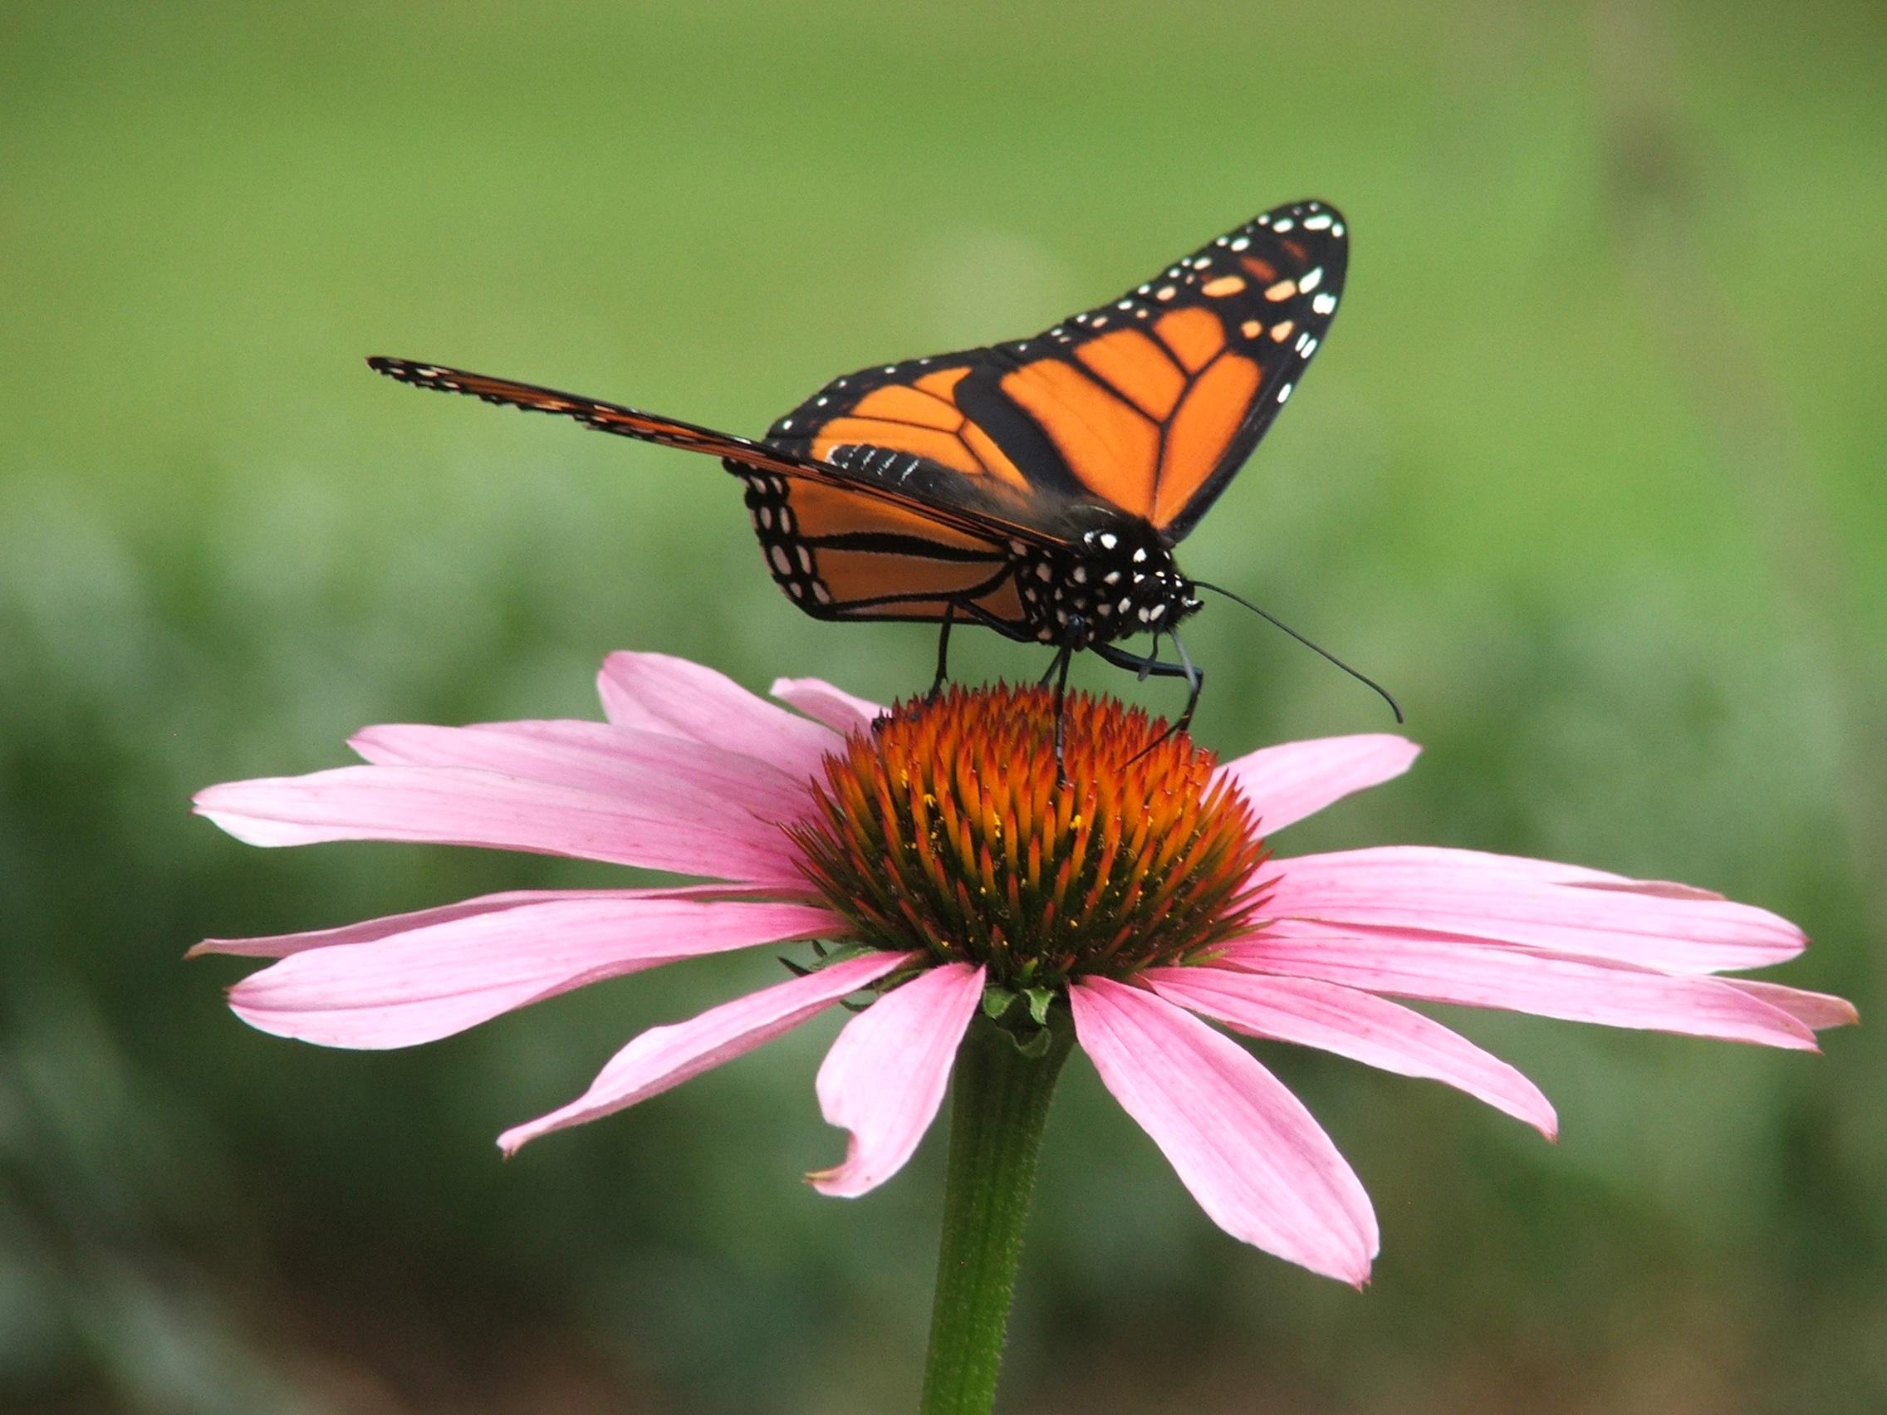
Objective and Methods
Example Onset/Peak/End Date Flowering Curve
Monarch butterfly feeding from Eastern Purple Coneflower.
Use of citizen science data from Nature’s Notebook
Understand when nectar plants are flowering
Inform when and where Monarchs have food resources
Peak
Onset
End
http://www.thepaintboxgarden.com/tag/monarch-butterfly-migration/
Notes:
----- Meeting Notes (4/5/17 11:27) -----
Spend more time here
Add arrows pointing to onset, peak, end

Slide 4
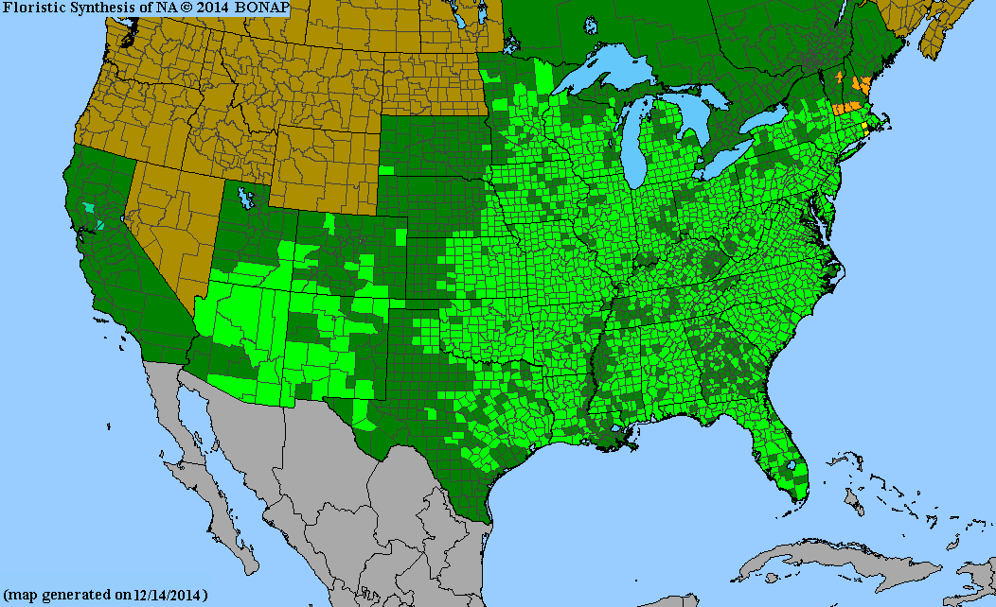
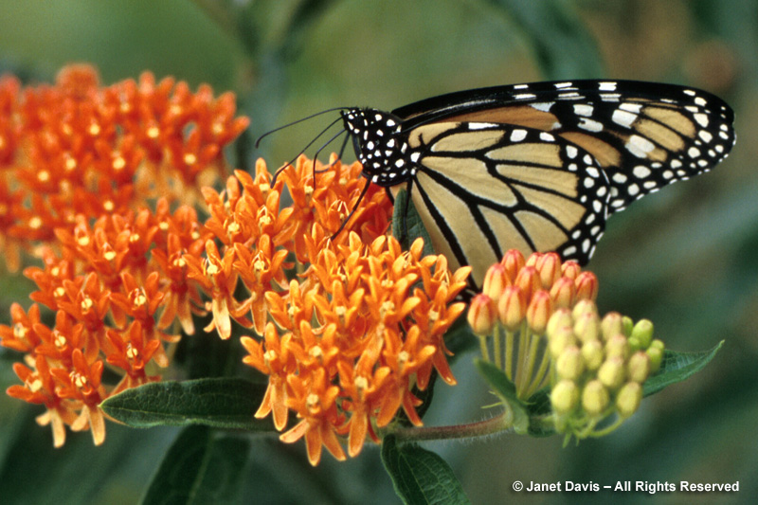
Questions we Asked:
Monarch butterfly feeding from Butterfly Milkweed.
Distribution Map for Asclepias Tuberosa
(Butterfly Milkweed)
How frequently are observations made? How precisely?
How do patterns of onset and peak date vary from year to year?
How do patterns of onset date and peak date vary in terms of latitude?
How do patterns vary between species?
Native to County
Native to State
Sites Used in Analysis
http://www.pics4learning.com/details.php?img=dscf4553.jpg
Notes:
Here, say for the sake of this presentation you focused on butterfly milkweed. An important plant because the adult butterflies consume its nectar, and the larvae use milkweed leaves to develop
----- Meeting Notes (4/5/17 11:27) -----
MOVE B MILKWEED MAPS HERE
Move b milkweed picture here

Slide 5
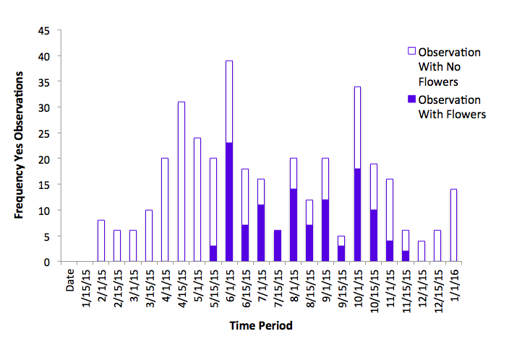
How Frequently are Butterfly Milkweed Observed?
For Butterfly milkweed, we assessed:
Frequency of observations
Precision that onset dates were captured
Notes:
This is an example of observation patterns from 2015. Additionally, for any given year only 2 to 22% of the individuals observed are observed consistently and with abundance values.
----- Meeting Notes (4/5/17 11:27) -----
Better define no/yes (observers are asked to define whether or not they saw flowering, which we can use to figure out onset of flowering)
Better define citizen science program

Slide 6
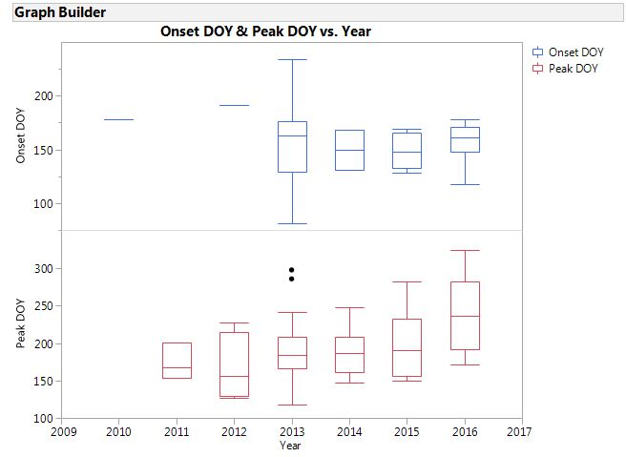
How do Onset and Peak Vary From Year to Year?
For Butterfly milkweed flowering:
Variability within and between years in timing of milkweed flowering
Trend towards later Peak date in recent years
Notes:
There was no clear trend in onset variance from year to year, however there was a consistent trend of peak dates occurring later in the year

Slide 7
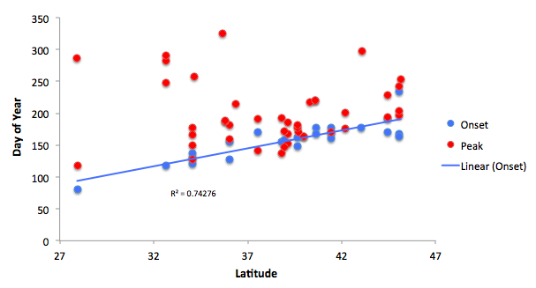
How do Onset and Peak Vary With Latitude?
For Butterfly milkweed flowering:
Onset dates occur later with increasing latitude
Peak dates did not shift with latitude
Notes:
The data for peak and latitude showed no significant trend (no strong correlation between the two), but the data for onset and latitude showed that as latitude increases the onset date will occur later in the year
Meeting Notes (4/5/17 11:27) -----

Slide 8
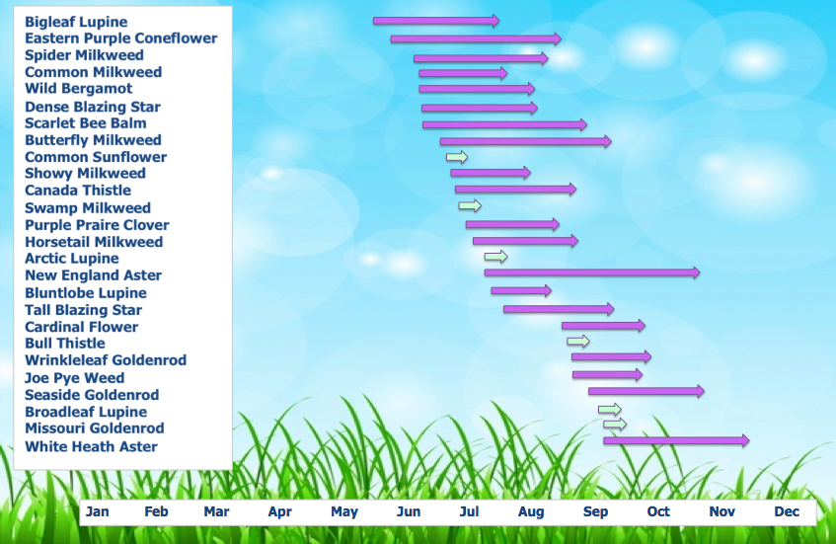

How Do Patterns in Onset Date Vary Between Species?
Data from 2010-2016 for all monarch nectar species monitored in Nature’s Notebook
Notes:
The calendar shows the general flowering period for all of the nectar plants used by monarchs that are being monitored in the Nature’s Notebook program, shows the wide range of flowering periods and onset dates that different species have
----- Meeting Notes (4/5/17 11:27) -----
Based on the entire dataset from 2010-2016
Since we can see some don't have end date, need encouragement of capturing accurate end date (gives better idea of flowering period)
----- Meeting Notes (4/5/17 11:27) -----
Talk more about campaign-when to tell observers, discuss nectar connector program

Slide 9
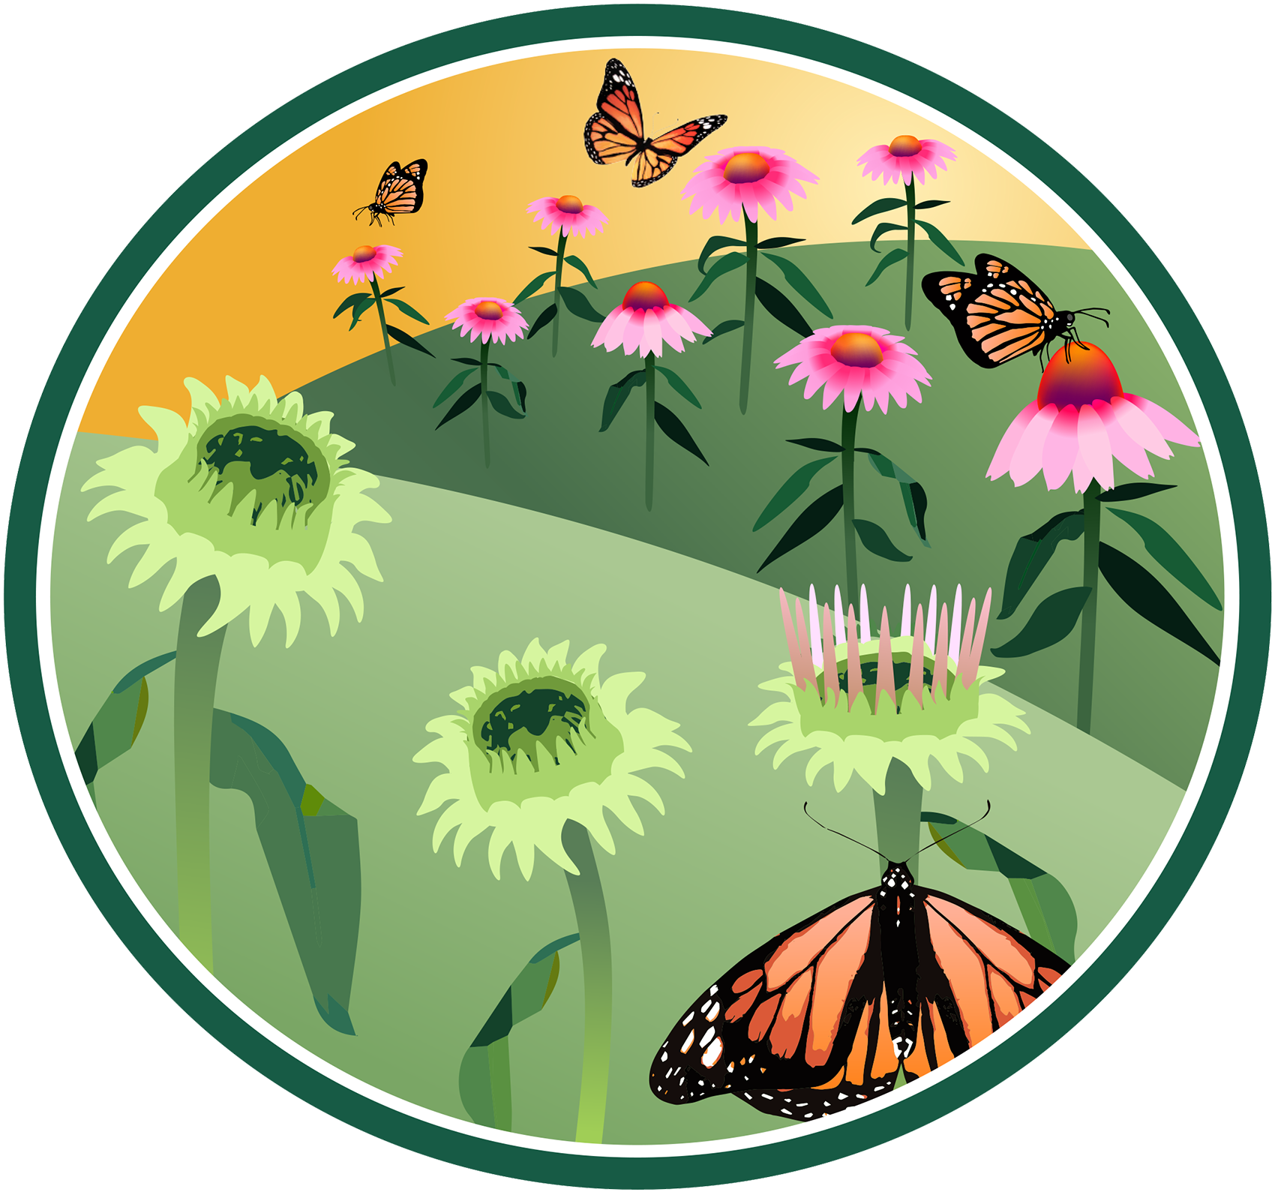
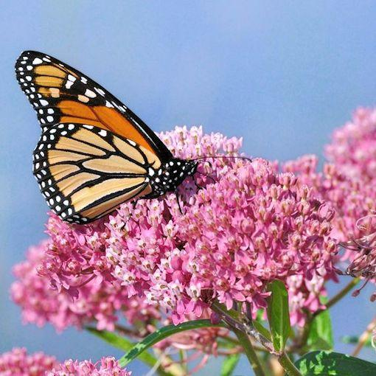
Application and Next Steps
Monarch butterfly feeding from Swamp Milkweed.
Increased monitoring
  Nectar Connectors Campaign
Better understanding of monarch population size/distribution
USA-NPN Nectar Connectors Badge
http://www.joyfulbutterfly.com/product/swamp-milkweed/
Notes:
In terms of understanding the nectar plants, having a general idea of when and where to observe the plants can help increase their monitoring, creating a more complete picture of how flowering trends are changing based on factors such as latitude, elevation, and climate. While the trends found are important, it would be interesting to also consider the distribution of observation sites for each species to see if the sample size is large enough for the differences to be inherently accounted for (does butterfly milkweed really flower later or does it appear to because it’s mostly monitored at higher latitudes), also would indicate need for increased monitoring
----- Meeting Notes (4/5/17 11:27) -----
Talk more about campaign-when to tell observers, discuss nectar connector program

Slide 10
Acknowledgements
Data were provided by the USA National Phenology Network (www.usanpn.org) and the many participants who contribute to its Nature’s Notebook program

Slide 11
Thank You
Notes:
----- Meeting Notes (4/5/17 11:27) -----
Add acknowledgement slide-contributers to USA NPN database
Maybe add other graphs on other slide for after

